Slide 1
Lifeline: A Campus Safety App
Muhammed Habibovic
mhabi13@lsu.edu
(504) 228-2387
An online version of this presentation is available at mhabibovic.com/lifeline.pdf

Slide 2
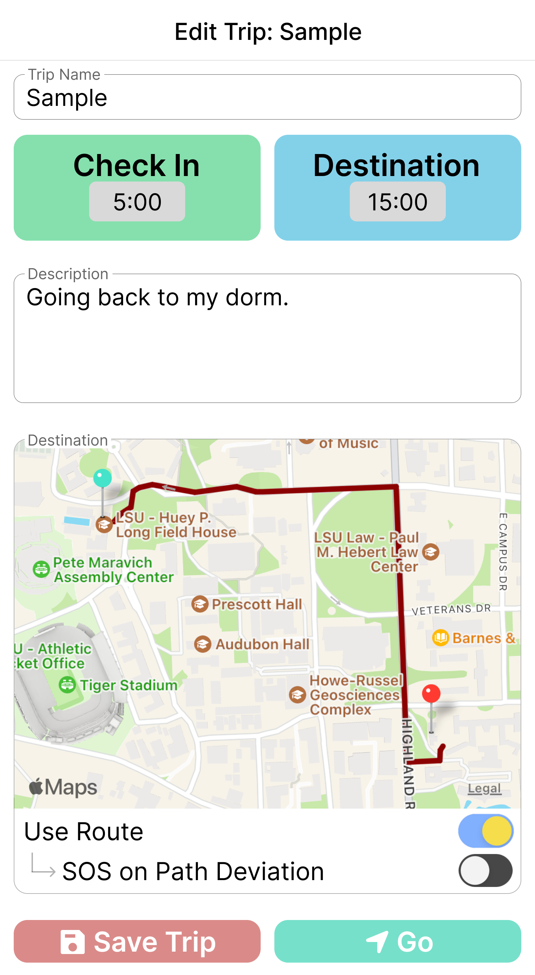
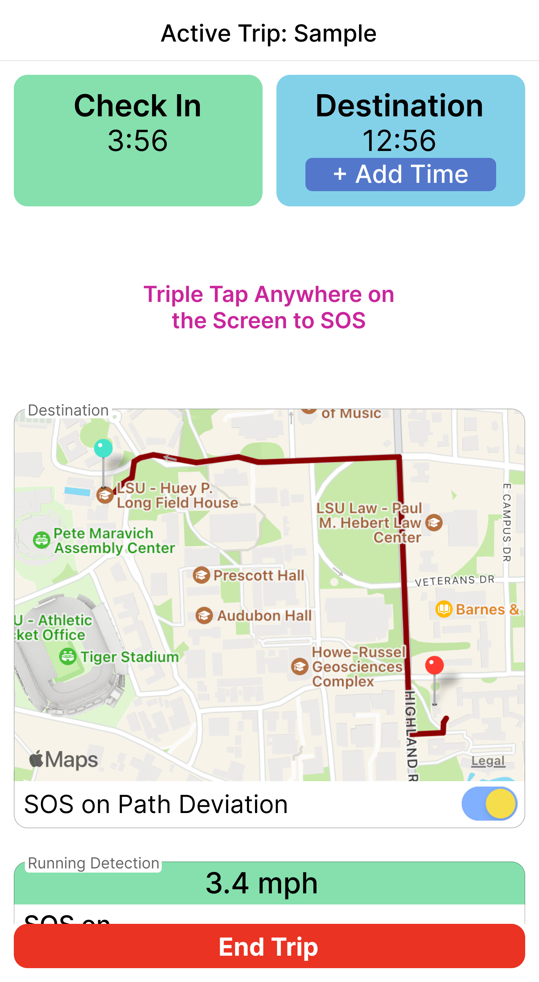
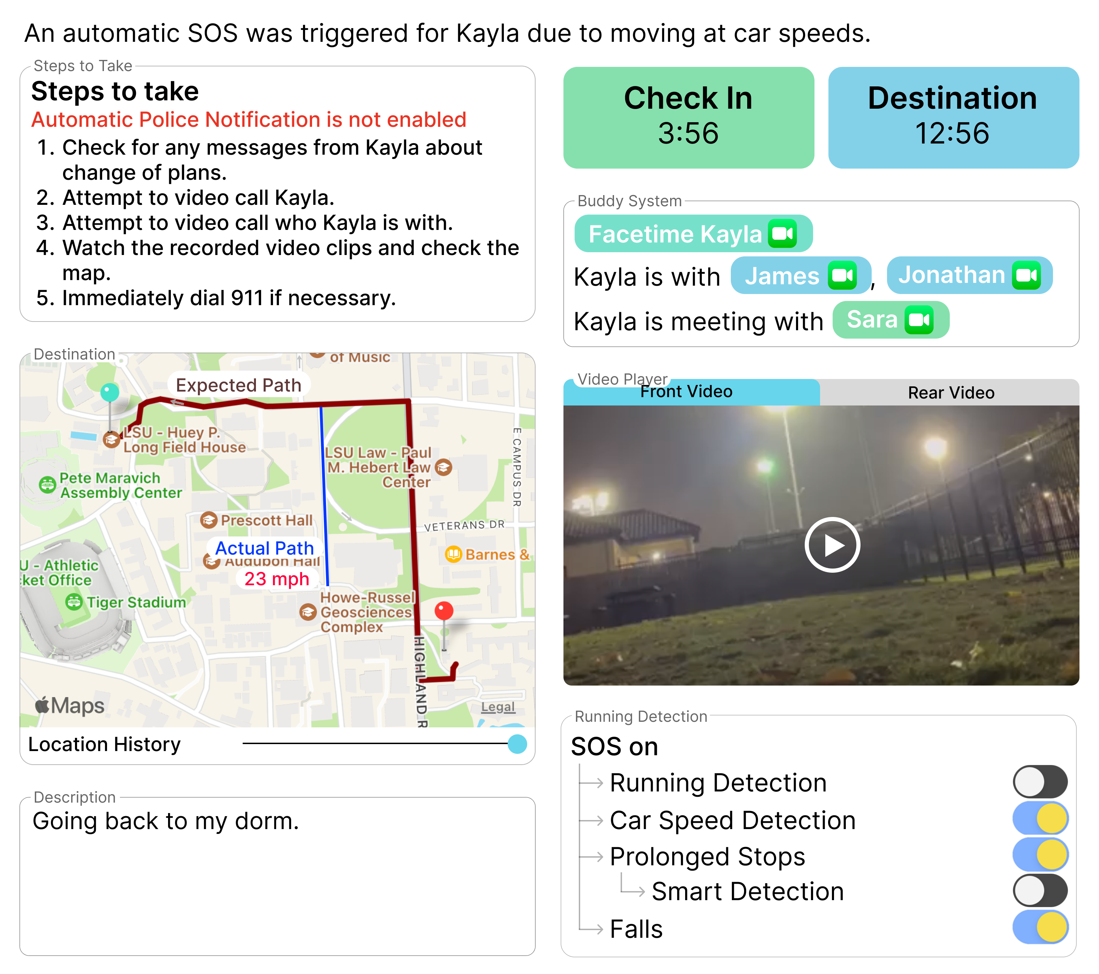
Overview
Trip is Started
Incident is Detected
Possible Incident: notification to emergency contacts and/or LSU PD with comprehensive data for rapid response.
Lifeline is a modern, free, and easy to use app with advanced features intended to make travel on campus safer.

Slide 3
Motivation
Despite modern technology like cameras and advanced forensics, many offenders go unpunished
Many crimes could be prevented and victimization spared if immediately detected
Inspired by my personal experience with violent crime, I aim for Lifeline to be a trusted tool to ensure student safety
https://www.rainn.org/statistics/campus-sexual-violence
https://newsroom.adt.com/safe-stories/research-finds-82-percent-american-college-students-are

Slide 4
Lifeline App
Greatly Improved Advanced Incident Detection
Easy Response to Incidents
Use Encouragement
Check in Intervals & Easy SOS while Fleeing
360 Video/Audio to Ensure Capture of Assailants and Events
Modern & User-Friendly Interface
Movement Awareness for Abduction Detection
Location History to See What Went Wrong & When
Ability to Only Notify Contacts During Incidents, Encouraging Use With Parents & Friends
Decoy Passcode in Case of Coercion by Assailants
Easy Dashboard for Emergency Contact Incident Management
FriendSystem Ensures Safety at Outings
Buddy System Monitors for Unexpected Separation
Easy Integration With LSU PD For Rapid Response

Slide 5
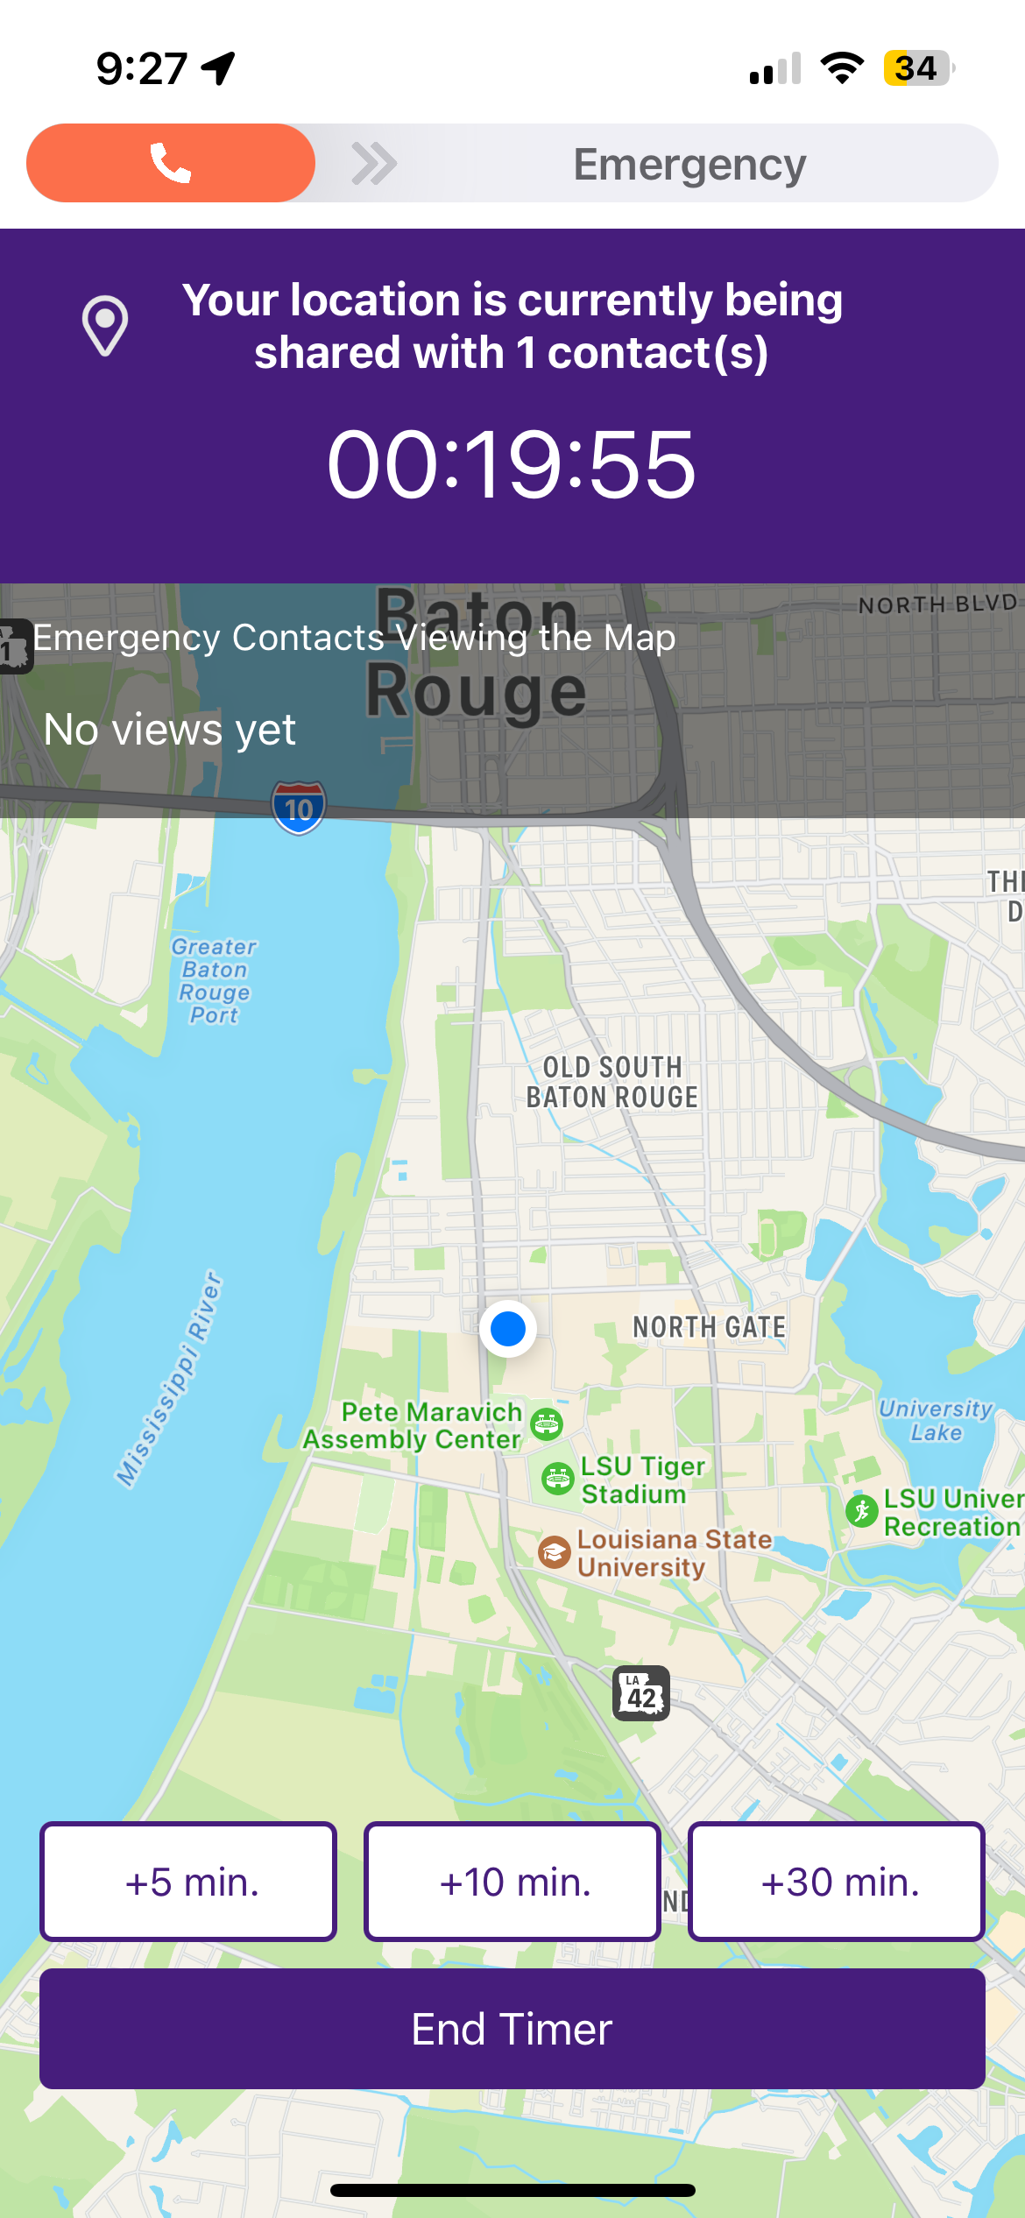
Lifeline App Provides Check in Intervals Rather than Check in Just at End & Easy SOS Triggering While Fleeing
Lifeline App
LSU Shield App
Difficult to use SOS slider while fleeing from assailants
Must unlock phone, even more difficult
Only Indication that something has gone wrong with LSU Shield is when timer expires
No check in intervals
Time can be added without passcode, neutralizing the only method of detection if phone is taken
Time to destination is tracked
Check in with passcode required at pre-set intervals
Myriad of other incident detection techniques
Easy Triple Tap Anywhere on Screen to trigger SOS
Easily done while running
No need to unlock phone

Slide 6
Lifeline App
Greatly Improved Advanced Incident Detection
Easy Response to Incidents
Use Encouragement
Check in Intervals & Easy SOS while Fleeing
360 Video/Audio to Ensure Capture of Assailants and Events
Modern & User-Friendly Interface
Movement Awareness for Abduction Detection
Location History to See What Went Wrong & When
Ability to Only Notify Contacts During Incidents, Encouraging Use With Parents & Friends
Decoy Passcode in Case of Coercion by Assailants
Easy Dashboard for Emergency Contact Incident Management
FriendSystem Ensures Safety at Outings
Buddy System Monitors for Unexpected Separation
Easy Integration With LSU PD For Rapid Response

Slide 7

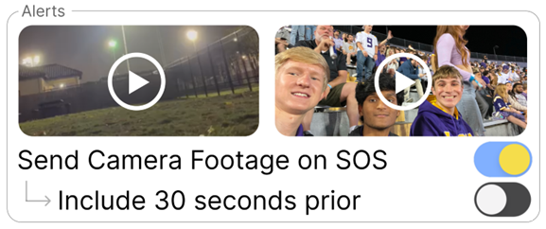
Lifeline App Transmits Video & Audio From Incident for Identification of Abductors Resulting in Victim Recovery & Conviction
Lifeline App Trip Settings
Info Screen For Emergency Contacts
Up to 30 seconds of video & audio with 360 view is transmitted upon incident detection.

Slide 8
Lifeline App
Greatly Improved Advanced Incident Detection
Easy Response to Incidents
Use Encouragement
Check in Intervals & Easy SOS while Fleeing
360 Video/Audio to Ensure Capture of Assailants and Events
Modern & User-Friendly Interface
Movement Awareness for Abduction Detection
Location History to See What Went Wrong & When
Ability to Only Notify Contacts During Incidents, Encouraging Use With Parents & Friends
Decoy Passcode in Case of Coercion by Assailants
Easy Dashboard for Emergency Contact Incident Management
FriendSystem Ensures Safety at Outings
Buddy System Monitors for Unexpected Separation
Easy Integration With LSU PD For Rapid Response

Slide 9
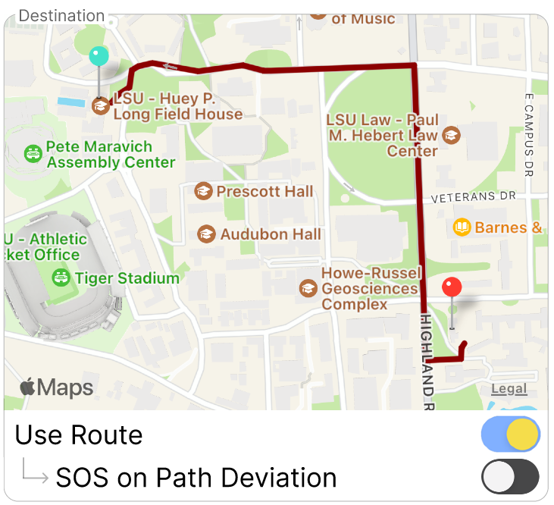
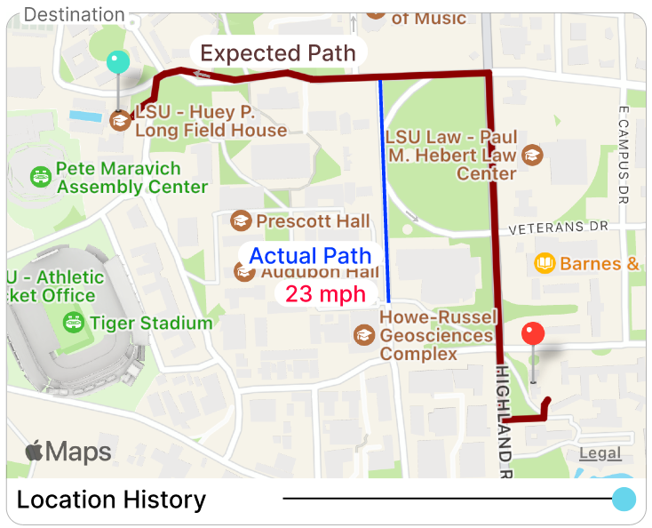
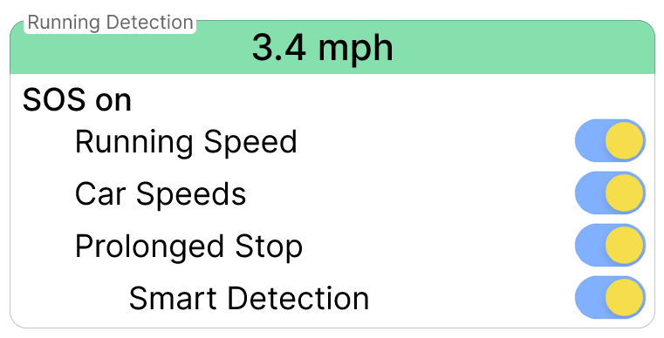
Lifeline App Provides Destination & Area Selection With Alerts for Deviation to Detect Abductions
Lifeline App Trip Settings
Info Screen for Emergency Contacts
AI analyzes route to determine if it is a reasonable path
If path is deviated from, contacts will receive emergency alerts with live location & history
Advanced triggers for:
Running detection
Help is needed
Car speed detection
Possible abduction
Prolonged stop
Possible assault
Notes:
Setting Path with Automatic Alerts for Deviating

Slide 10
Lifeline App
Greatly Improved Advanced Incident Detection
Easy Response to Incidents
Use Encouragement
Check in Intervals & Easy SOS while Fleeing
360 Video/Audio to Ensure Capture of Assailants and Events
Modern & User-Friendly Interface
Movement Awareness for Abduction Detection
Location History to See What Went Wrong & When
Ability to Only Notify Contacts During Incidents, Encouraging Use With Parents & Friends
Decoy Passcode in Case of Coercion by Assailants
Easy Dashboard for Emergency Contact Incident Management
FriendSystem Ensures Safety at Outings
Buddy System Monitors for Unexpected Separation
Easy Integration With LSU PD For Rapid Response

Slide 11
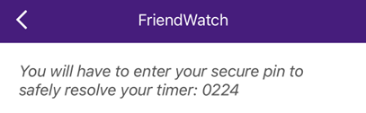
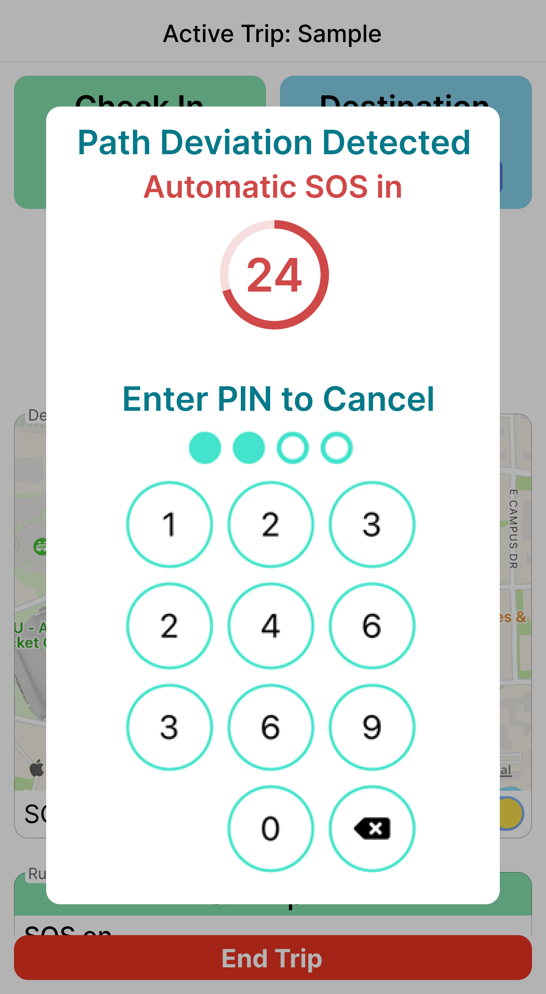
Lifeline App Allows for User to Create a Decoy Passcode in Case of Coercion by Assailants
LSU Shield App
Lifeline App
Lifeline app allows for custom passcode & decoy passcode
If decoy passcode is used, app will act as if correct one was used
Once set, no way to tell if passcode is decoy
Decoy Passcode immediately triggers incident & notifies emergency contacts with video, audio, & live location & history with no indication to assailant
LSU Shield App provides a passcode to user, no ability to set custom or decoy

Slide 12
Lifeline App
Greatly Improved Advanced Incident Detection
Easy Response to Incidents
Use Encouragement
Check in Intervals & Easy SOS while Fleeing
360 Video/Audio to Ensure Capture of Assailants and Events
Modern & User-Friendly Interface
Movement Awareness for Abduction Detection
Location History to See What Went Wrong & When
Ability to Only Notify Contacts During Incidents, Encouraging Use With Parents & Friends
Decoy Passcode in Case of Coercion by Assailants
Easy Dashboard for Emergency Contact Incident Management
FriendSystem Ensures Safety at Outings
Buddy System Monitors for Unexpected Separation
Easy Integration With LSU PD For Rapid Response

Slide 13
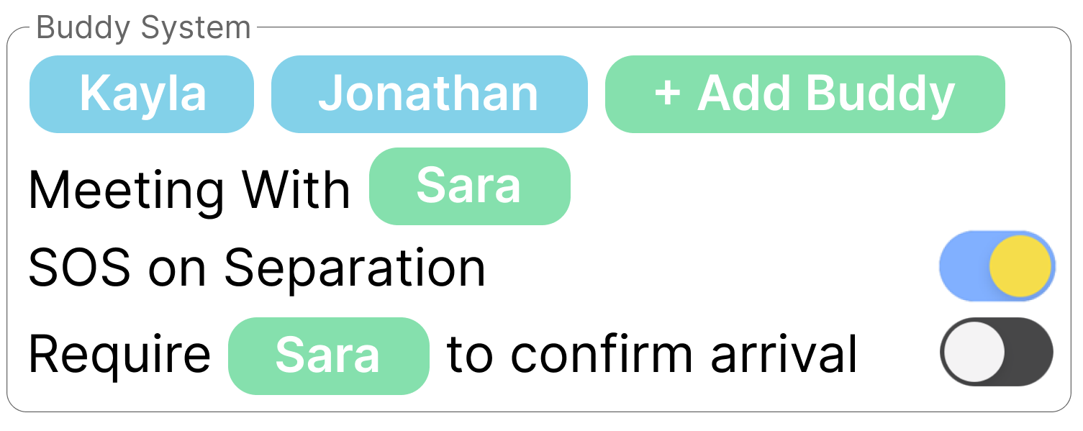
Lifeline App Includes Buddy System With SOS Alert if Unexpectedly Separated
Lifeline App Trip Settings
Info Screen For Emergency Contacts
User can add who they are going with
If others have app, SOS alert will trigger on separation
Can add who is at destination & require confirmation of arrival from that person
Emergency Contacts will have contact information for everyone user is travelling with & meeting

Slide 14
Lifeline App
Greatly Improved Advanced Incident Detection
Easy Response to Incidents
Use Encouragement
Check in Intervals & Easy SOS while Fleeing
360 Video/Audio to Ensure Capture of Assailants and Events
Modern & User-Friendly Interface
Movement Awareness for Abduction Detection
Location History to See What Went Wrong & When
Ability to Only Notify Contacts During Incidents, Encouraging Use With Parents & Friends
Decoy Passcode in Case of Coercion by Assailants
Easy Dashboard for Emergency Contact Incident Management
FriendSystem Ensures Safety at Outings
Buddy System Monitors for Unexpected Separation
Easy Integration With LSU PD For Rapid Response

Slide 15
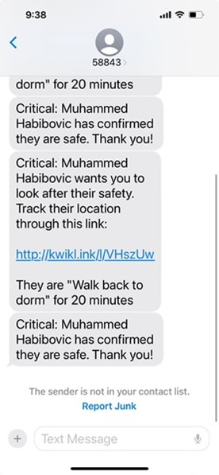
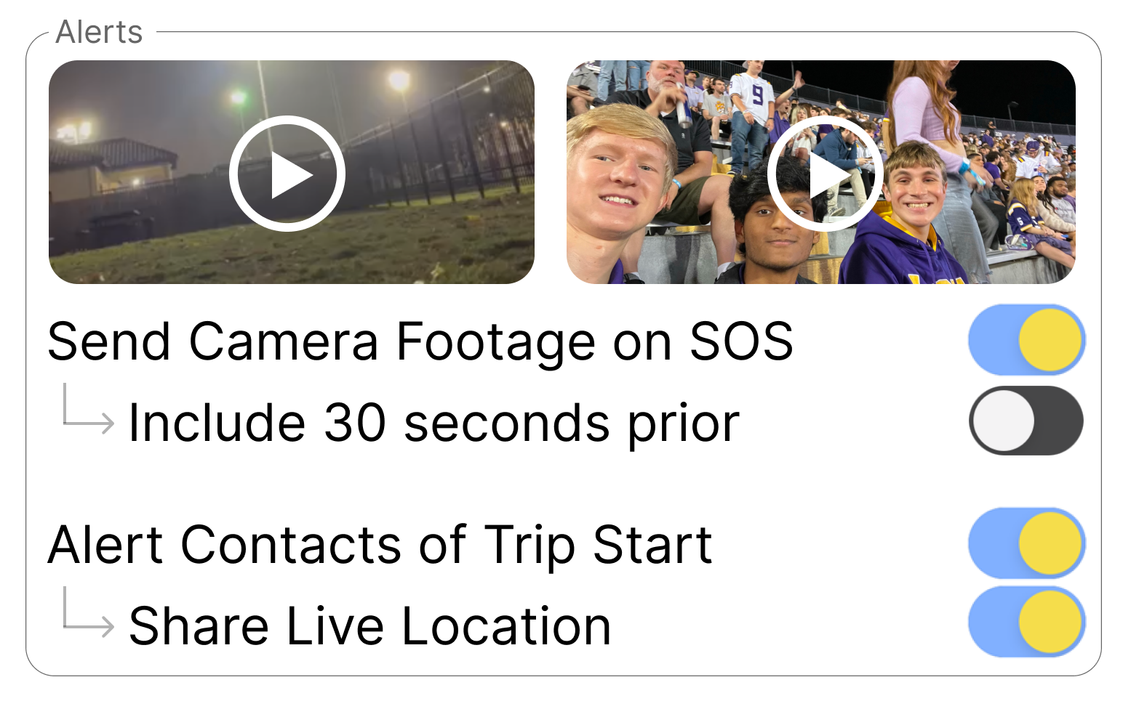

Lifeline App Allows for Emergency Contacts to Only be Notified During Incidents, Encouraging Use with Parents & Friends
Lifeline App
LSU Shield App
Emergency contact receives text at start of trip with details
Discourages use with parents as most college students don’t want parents to know everything
Students may feel they are being “annoying” by constantly sending alerts to friends
Contacts can be notified only in case of incident
Students much more likely to use with parents and enter accurate trip data for emergencies

Slide 16
Lifeline App
Greatly Improved Advanced Incident Detection
Easy Response to Incidents
Use Encouragement
Check in Intervals & Easy SOS while Fleeing
360 Video/Audio to Ensure Capture of Assailants and Events
Modern & User-Friendly Interface
Movement Awareness for Abduction Detection
Location History to See What Went Wrong & When
Ability to Only Notify Contacts During Incidents, Encouraging Use With Parents & Friends
Decoy Passcode in Case of Coercion by Assailants
Easy Dashboard for Emergency Contact Incident Management
FriendSystem Ensures Safety at Outings
Buddy System Monitors for Unexpected Separation
Easy Integration With LSU PD For Rapid Response

Slide 17
Lifeline App Includes an Easy Dashboard for Incident Management by Emergency Contacts
Lifeline Trip Info Screen
Key details regarding trip
Reason for incident report
Map with live location & history
Trip Description
Time left
Travel buddies with contact information to ensure safety
Video & Audio of Incident
Trip Settings
Steps to take are listed to ensure rational thinking & beneficial actions are taken in dire times

Slide 18
Lifeline App
Greatly Improved Advanced Incident Detection
Easy Response to Incidents
Use Encouragement
Check in Intervals & Easy SOS while Fleeing
360 Video/Audio to Ensure Capture of Assailants and Events
Modern & User-Friendly Interface
Movement Awareness for Abduction Detection
Location History to See What Went Wrong & When
Ability to Only Notify Contacts During Incidents, Encouraging Use With Parents & Friends
Decoy Passcode in Case of Coercion by Assailants
Easy Dashboard for Emergency Contact Incident Management
FriendSystem Ensures Safety at Outings
Buddy System Monitors for Unexpected Separation
Easy Integration With LSU PD For Rapid Response

Slide 19
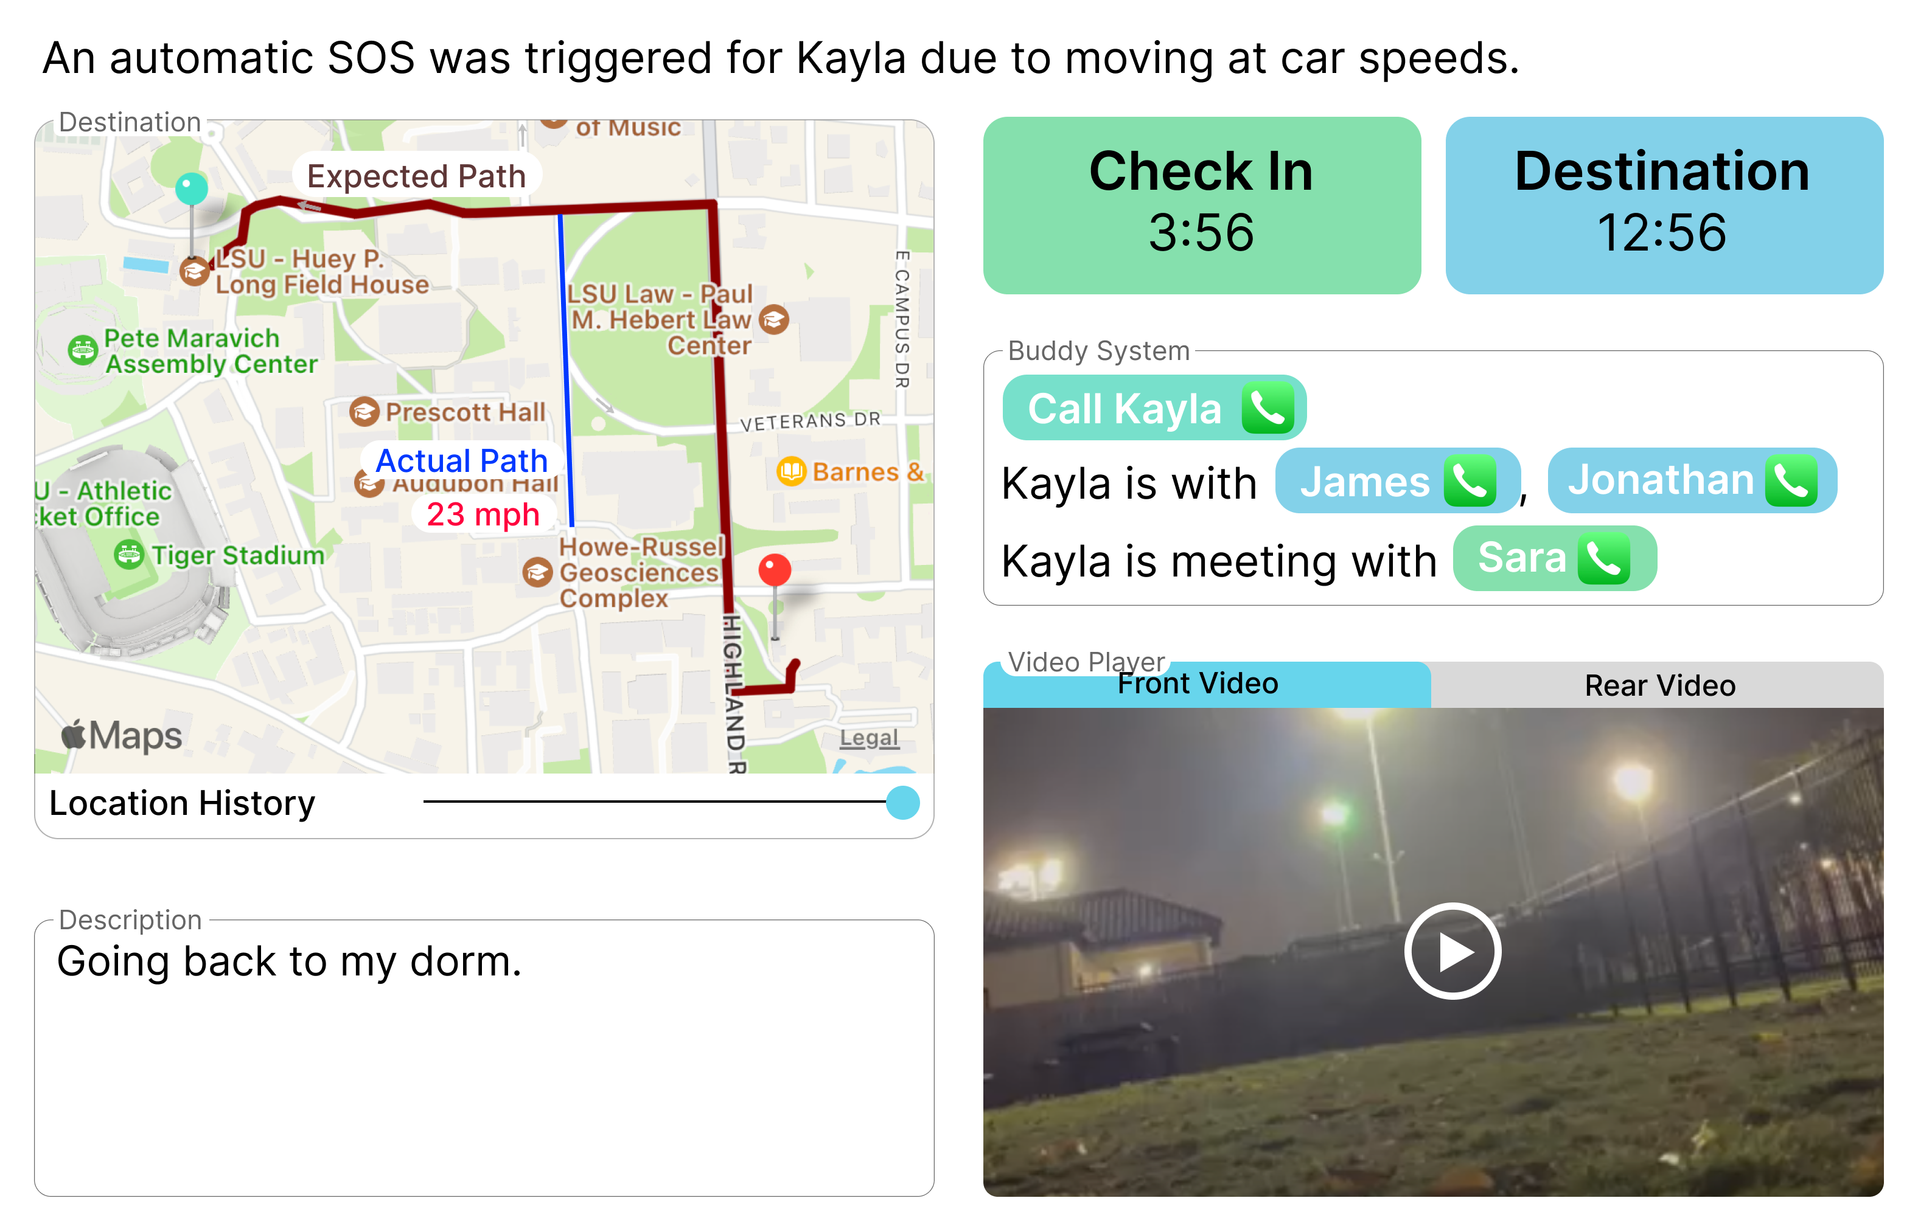
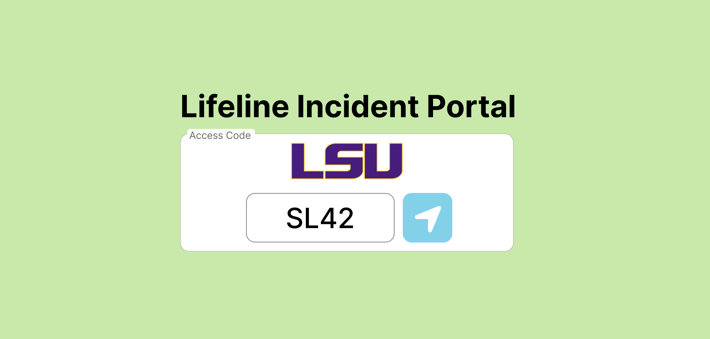
Lifeline App Will Allow for Trivial LSU PD Integration
Lifeline App Trip Settings
Integration is trivial: LSU PD Dispatch receives an automated call with a code, enters it into secure website, views information
No new software is needed for LSU PD

Slide 20
Lifeline App
Greatly Improved Advanced Incident Detection
Easy Response to Incidents
Use Encouragement
Check in Intervals & Easy SOS while Fleeing
360 Video/Audio to Ensure Capture of Assailants and Events
Modern & User-Friendly Interface
Movement Awareness for Abduction Detection
Location History to See What Went Wrong & When
Ability to Only Notify Contacts During Incidents, Encouraging Use With Parents & Friends
Decoy Passcode in Case of Coercion by Assailants
Easy Dashboard for Emergency Contact Incident Management
FriendSystem Ensures Safety at Outings
Buddy System Monitors for Unexpected Separation
Easy Integration With LSU PD For Rapid Response

Slide 21
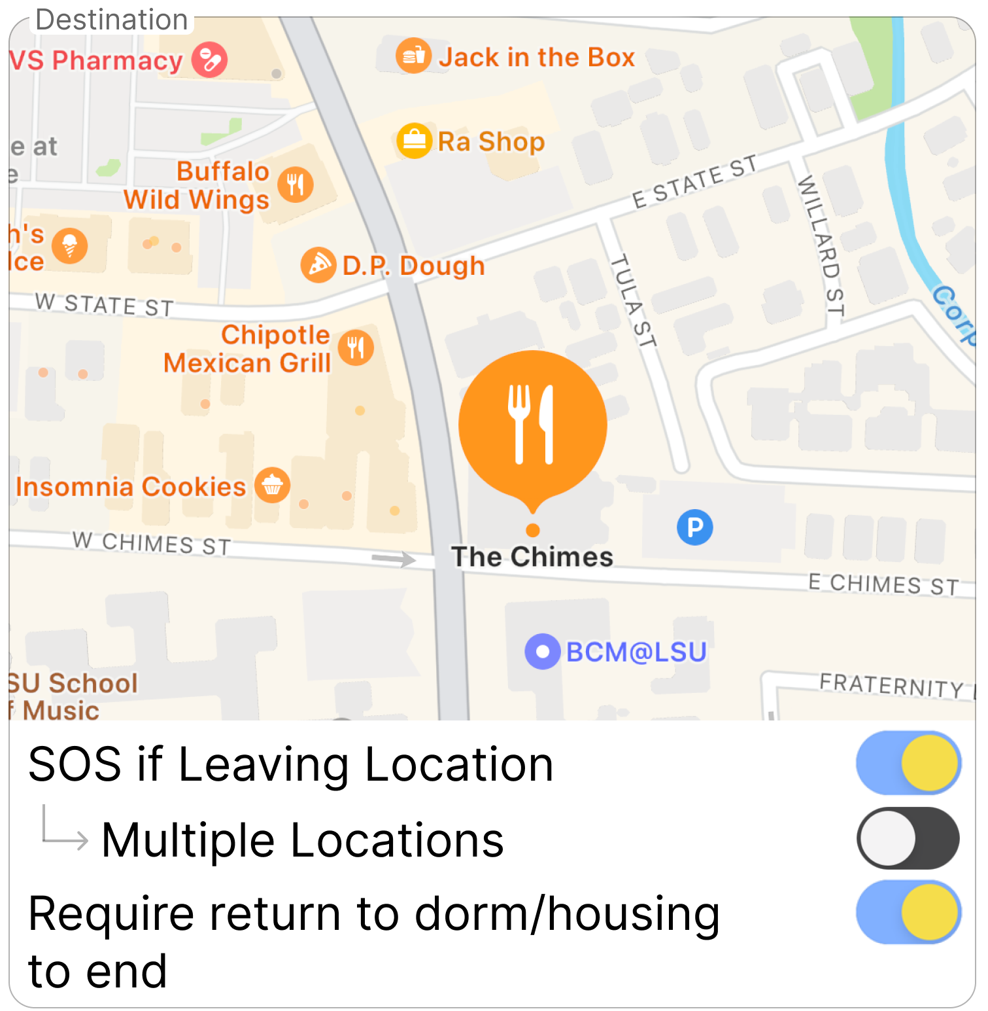
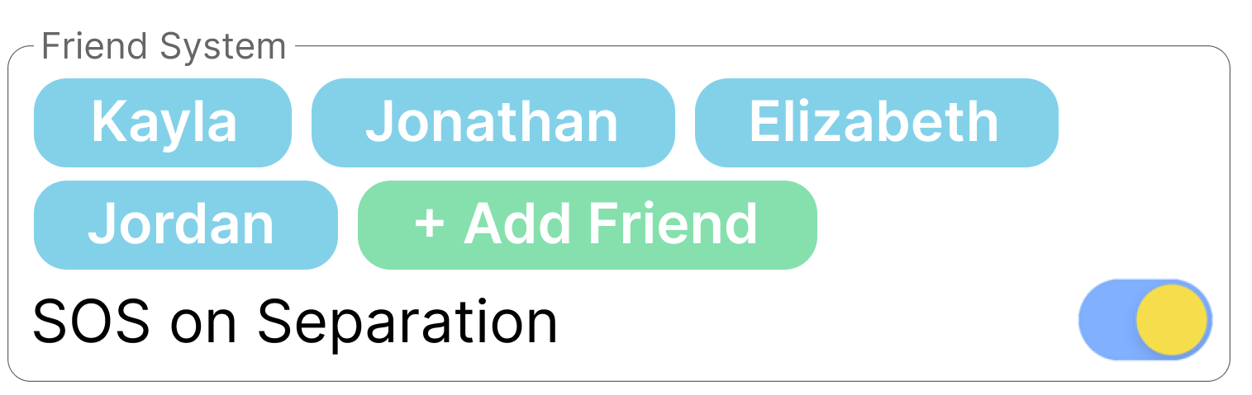
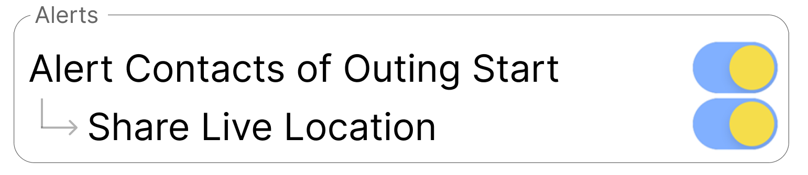
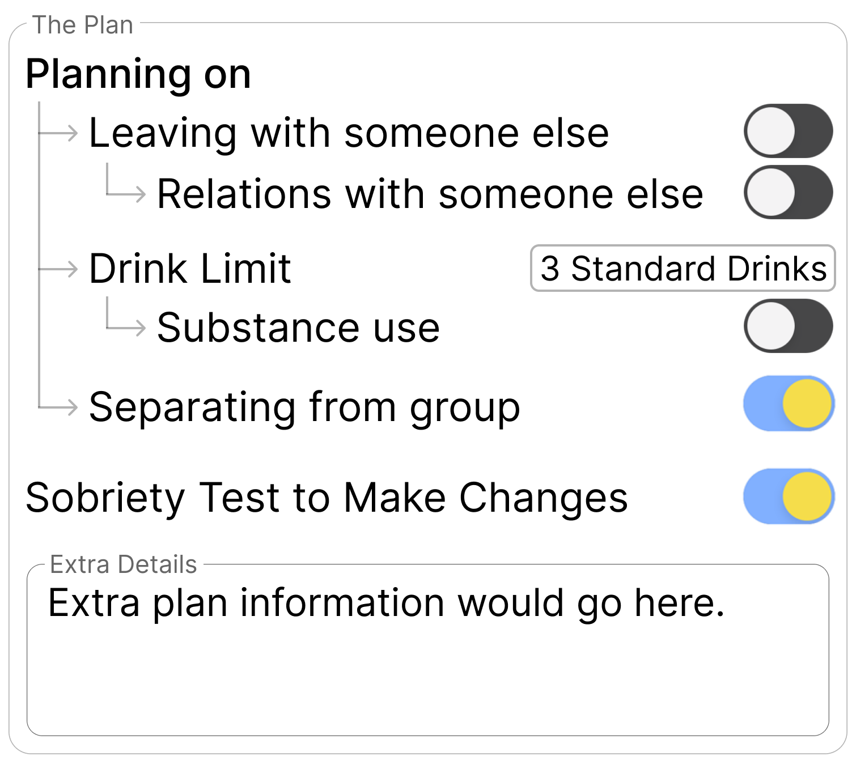
FriendSystem Ensures Safety at Outings Such as Bars & Frat Parties
Often at Bars of Frat Parties, a student in a friend group is left behind for a multitude of reasons.
Unscrupulous persons may try to take advantage of the situation
FriendSystem helps to ensure safety
Geofencing ensures users remain in safe areas
Listing the friend group ensures no one is left behind & emergency contacts can intervene if so
Parents do not have to be alerted of the start of the outing, which encourages students who know they can trust their parents but don’t want them knowing about their activities to use the app as a backup
A plan can be defined so friends know when to take concern with another friend’s actions

Slide 22
Conclusion
One of my principle passions is helping others. I want to ensure that no one else is a victim of violent crime, and if they are, that the tools exist to hold perpetrators responsible and provide victims with justice.
Lifeline will likely complete development in about a month and will be free to use.
I will try to spread it myself, but my influence is limited. The impact of Lifeline could be much greater with promotion and awareness campaigns focusing on the rich features and ease of use.
Integration with LSU PD will allow for a much greater impact.
Any feedback or suggestions for improvement are greatly appreciated.
A small monetary grant would allow for much easier scaling.

